Slide 1
To-do List Optimizer 1.0
Members: Manuel Garcia, Daniel Gonzalez and Salvador Ricardo
Product Owner: Monique Ross Mentor: Masoud Sadjadi

Slide 2
Problem
Busy schedules comprised of several tasks in different locations
Non-intuitive apps for easy task management and navigation
Multiple applications need to be used to keep track of daily tasks
Annoying swap between apps (e.g. Apple Reminders and Maps)

Slide 3
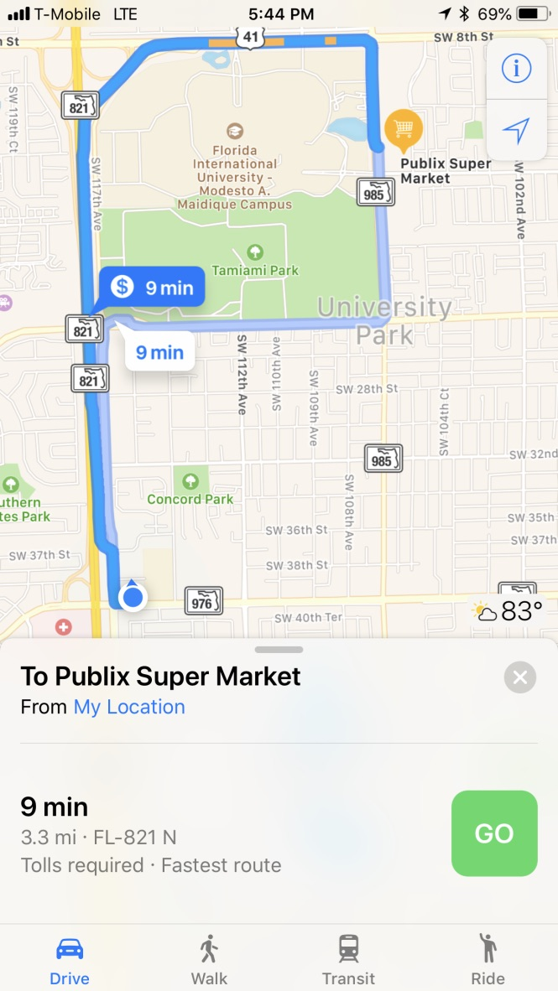
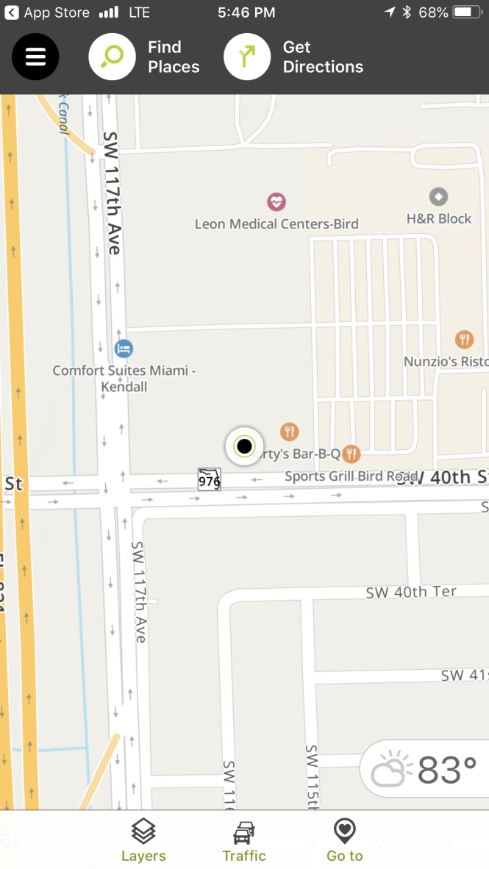
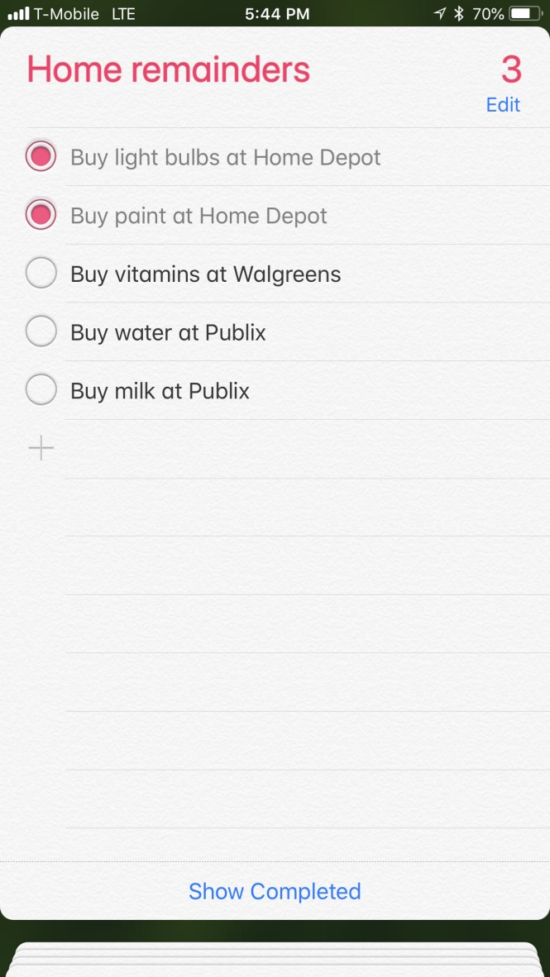
Current Systems
Apps that integrate task management and GPS navigation were not found
Crowed UIs that result in a poor UX
Some web applications allow the user to navigate to multiple places but the link between places and tasks is non-existent and those websites lack portability

Slide 4
Solution
Creation of an app that integrates the best of task management and navigation
Improved UI/UX for better usage of the app

Slide 5
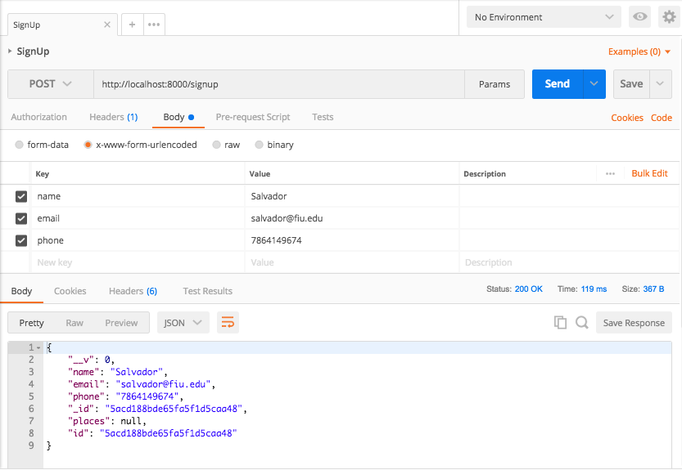
Persistent data throughout all devices
Cloud storage of all user data allows easy management of tasks from different devices.

Slide 6
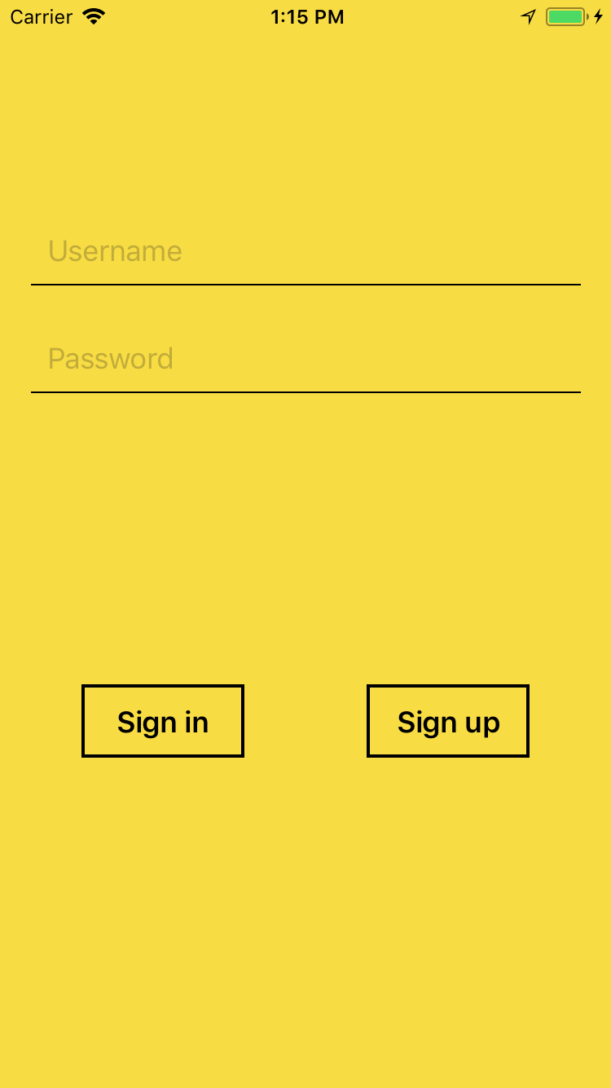
Easy Sign Up/Sign In
Intuitive and easy to use sign up/ sign in screen.
Secure transfer of credentials.

Slide 7

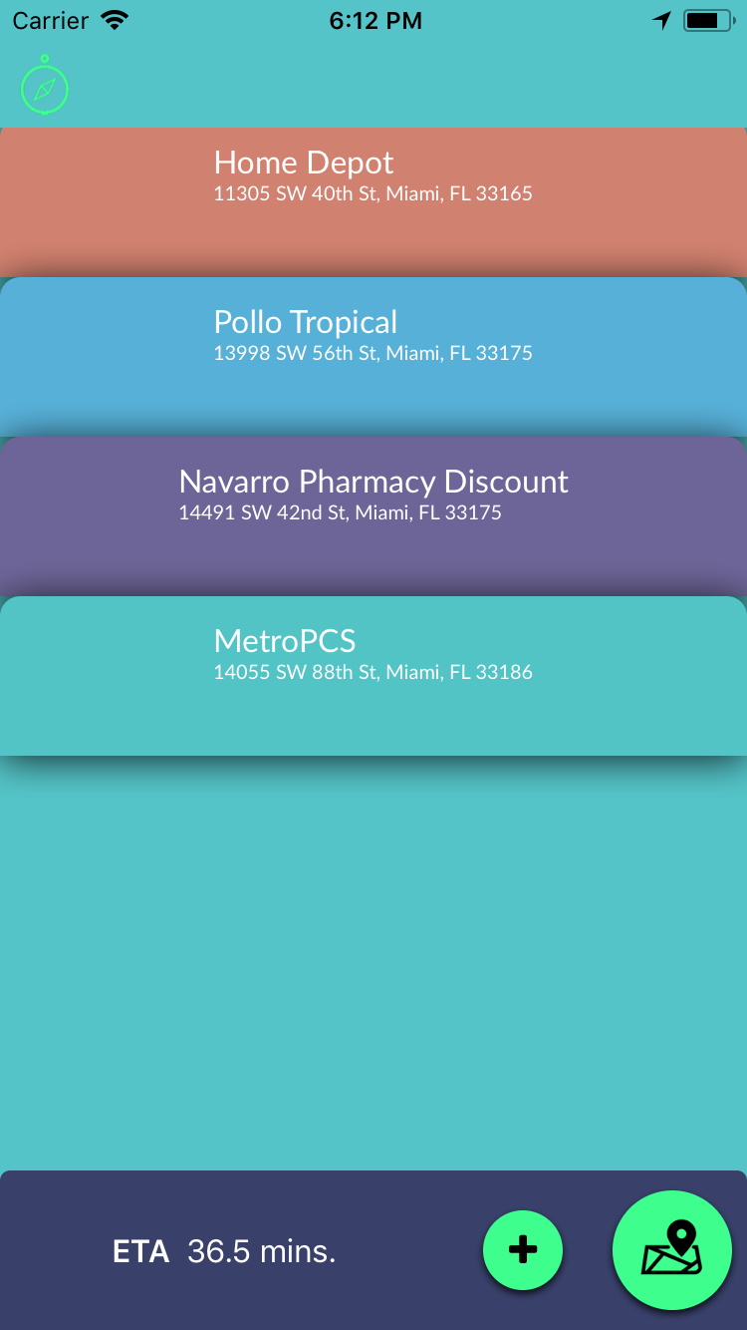
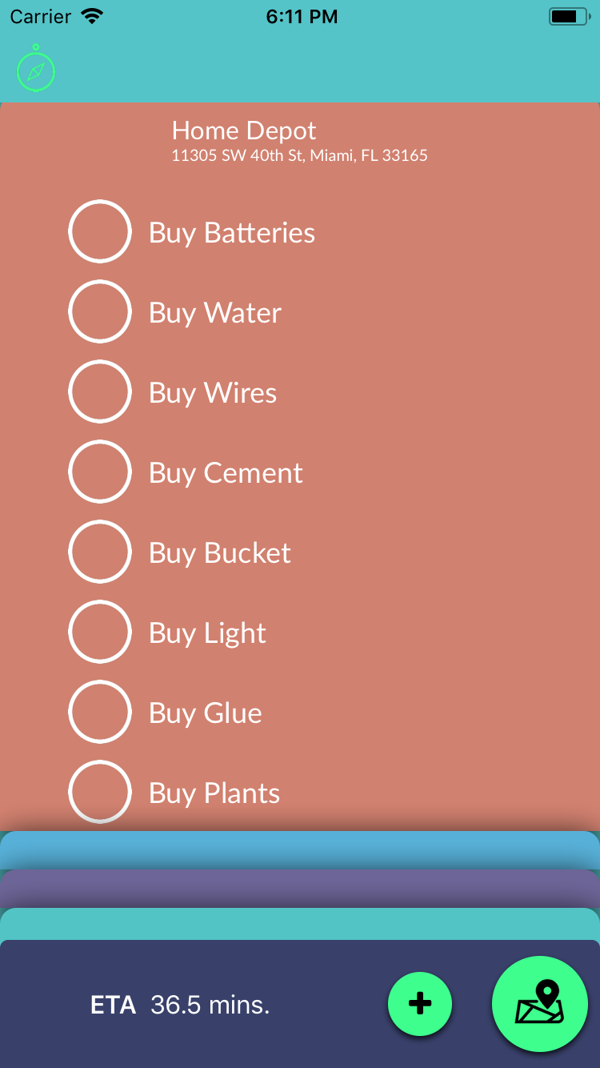
Intuitive display of information
Automatic ordering of places based on convenient route.
Easy access to tasks within each place.
Relevant information about itinerary duration dynamically changes with place additions.

Slide 8
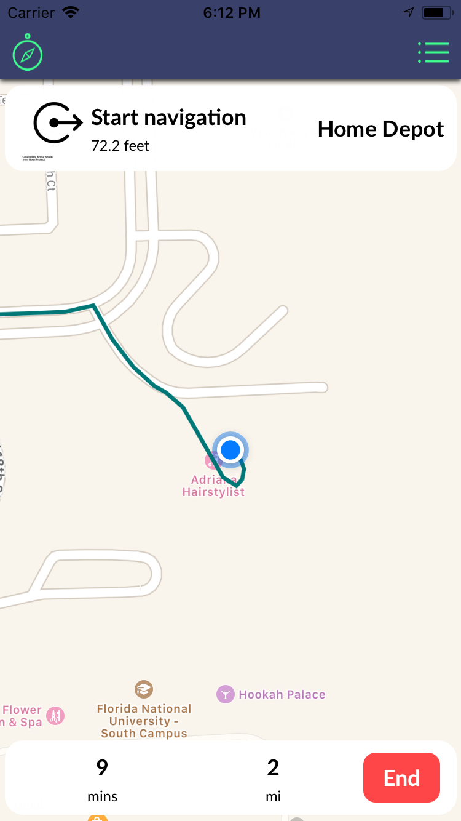
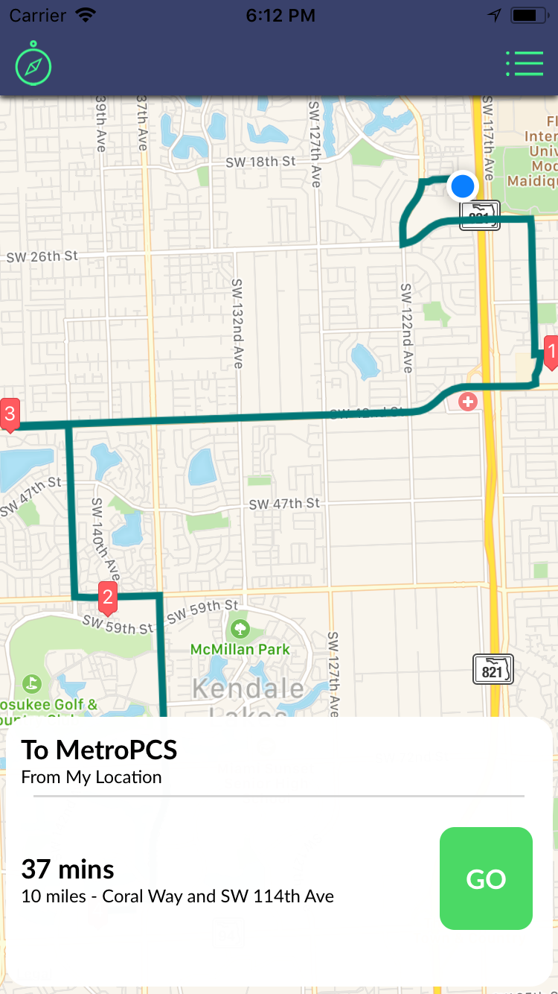
Guided Navigation
Overview of the trip for helping the user locate himself within the trip.
Statistics about the trip such as time and distance dynamically change.
Detail maneuver information.

Slide 9
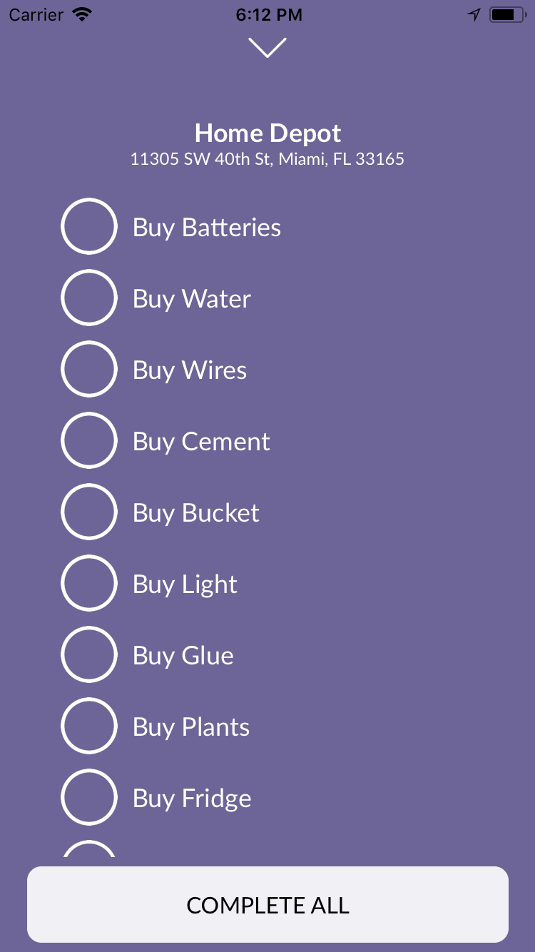
Smooth task management and navigation integration
Positioning awareness that allows smart handling of tasks once arrived to the closest place.
Easy management of user’s to-do list within each place.

Slide 10
Special Thanks
We would like to thank Dr. Monique Ross for her support during this semester in the realization of the first iteration of To-do List Optimizer

